Slide 1
Waste-to-Energy - Converting Municipal Waste into Electricity
Group D : Shaik,G, Silla, Shaik,A.
(Gafaruddin Shaik, Jhansimala Silla, Afrin Shaik)
Course Name (EMGT 5320/SYSE 5105)
May 5th, 2025

Slide 2
Agenda
Introduction & Background
Problem & Opportunity
Project Overview & Scope of Work
Work Breakdown Structure (WBS)
Project Network Diagram & Critical Path
Gantt Chart & Schedule
Cost Estimate & Budget Summary
Outsourcing Plan & Resource Loading
Risk Mitigation & Quality Control Plan
Monitoring, Change Orders, and Project Results
Lessons Learned & Project Summary
Q&A

Slide 3

Introduction
Rapid urbanization has led to growing municipal waste challenges
Traditional waste management practices (landfills, open burning) cause pollution
Waste-to-Energy (WTE) provides a sustainable solution - converts waste into usable electricity
Aligns with environmental and urban development goals

Slide 4
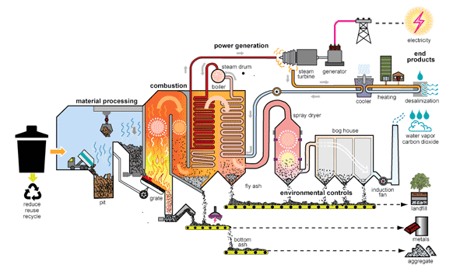

Slide 5
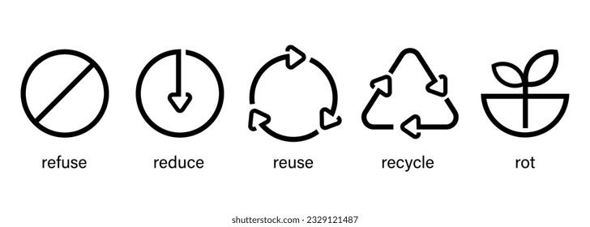
How It Fits into the Organization's Mission
Relevance:
Resolves landfill misuse and pollution problems.
Enables renewable energy production from waste.
Meets green policies and sustainability goals.
Mission Alignment:
Promotes Circular economy principles.
Reduces dependence on fossil fuels.
Promotes innovation in waste management.

Slide 6

Project Overview & Scope
Objective: Design and plan a municipal WTE plant to generate electricity Type: Engineering Design-Build Project Project Duration: 6 months Client: Municipal Government (Fictional) Estimated Cost: $391,771
Scope Includes:
Feasibility and requirement analysis
WTE technology selection and design layout
Plant construction and infrastructure setup
Testing, commissioning, operations onboarding
Handover, documentation, and reporting

Slide 7
Project Overview & Scope
Deliverables & Tasks – What Are the Outputs?
Research report on WTE technologies.
Conceptual design and feasibility study of the WTE plant.
Environmental impact assessment.
Cost and economic feasibility study.
Implementation and policy recommendations.
Milestones – Linked to Schedule
Week 1-4: Feasibility study & research.
Week 5-8: Projections of energy output & analysis of waste input.
Week 9-12: Emission control measures & conceptual plant design.
Week 13-15: Assessment of economic feasibility.
Week 16: Report submission & final presentation.

Slide 8

Problem/Opportunity & Technical Requirements
Problem: Municipal waste overload, environmental hazards, energy shortages
Opportunity: Transform waste into electricity, reduce landfill use, and provide renewable energy
Technical Requirements:
Incineration/gasification units capable of processing 200 tons/day
Emission control systems compliant with EPA regulations
Real-time data collection and performance monitoring systems

Slide 9

Work Breakdown Structure (WBS)
Project Initiation & Planning
Technology Choice & Design
Building & Infrastructure
Testing & Commissioning
Operations & Maintenance
Project Closure & Handover

Slide 10
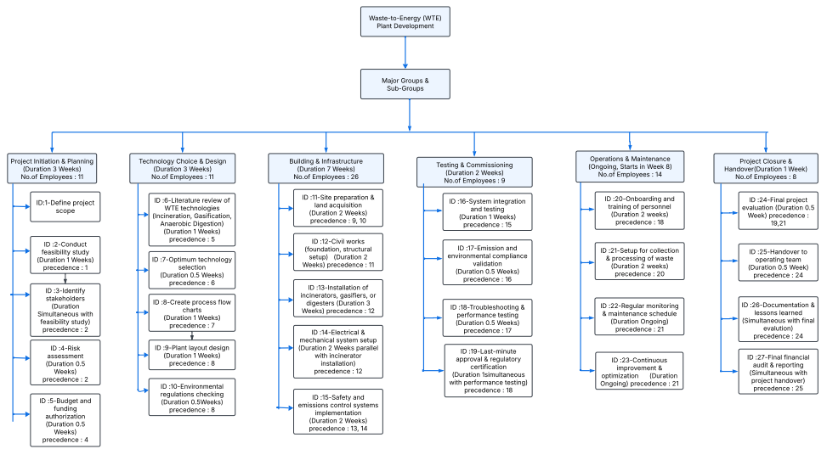

Slide 11
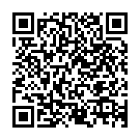
Project Network Diagram & Critical Path
Activities linked with precedence logic (AON format)
Longest path: Construction → Installation → Testing → Handover
Diagram highlights dependencies and sequencing.
https://drive.google.com/file/d/1SOjPAcAXtA750PXSme7NfVSU0c-iEcuC/view?usp=sharing
Scan this QR code to view the detailed Network Diagrams.

Slide 12
Project Network Diagram & Critical Path

Slide 13
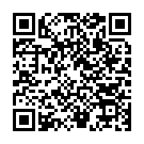
Gantt Chart & Timeline
Duration: 6 Months
Overlapping and parallel activities
Milestones: Tech Selection, Equipment Installation, System Testing, Final Handover.
https://drive.google.com/file/d/1zJeo4knbABQdNj7FbH5AV46LM9slXAvI/view?usp=sharing
Scan this QR code to view the detailed Gantt Chart.

Slide 14
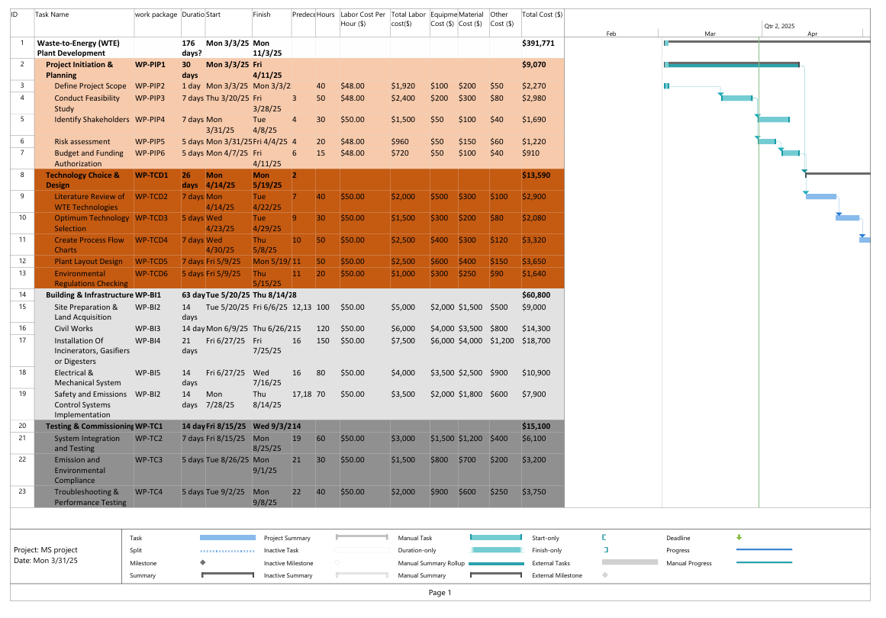
Gantt Chart & Timeline

Slide 15
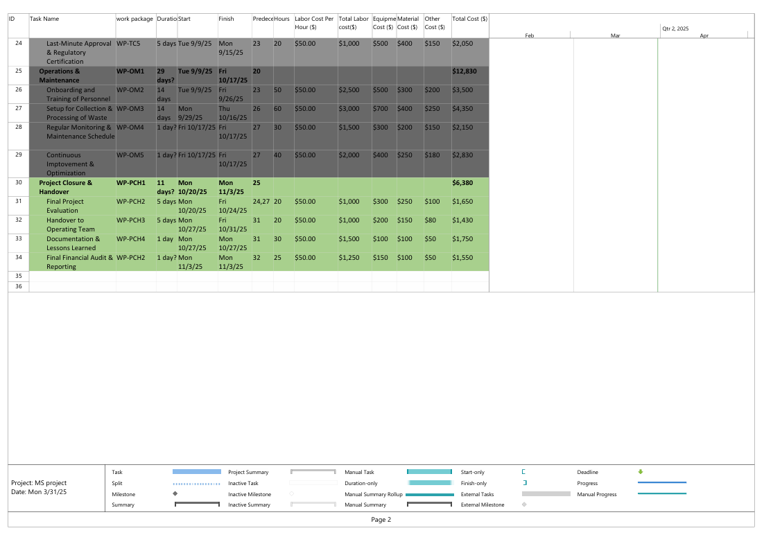
Gantt Chart & Timeline

Slide 16
Project Cost Estimate
Category | Cost ($)
Direct Costs | 117,770
Management Fee (10%) | 11,777
Overhead (116%) | 136,602
Contingency (15%) | 39,922
Profit (28%) | 85,700
Total Cost | 391,771

Slide 17
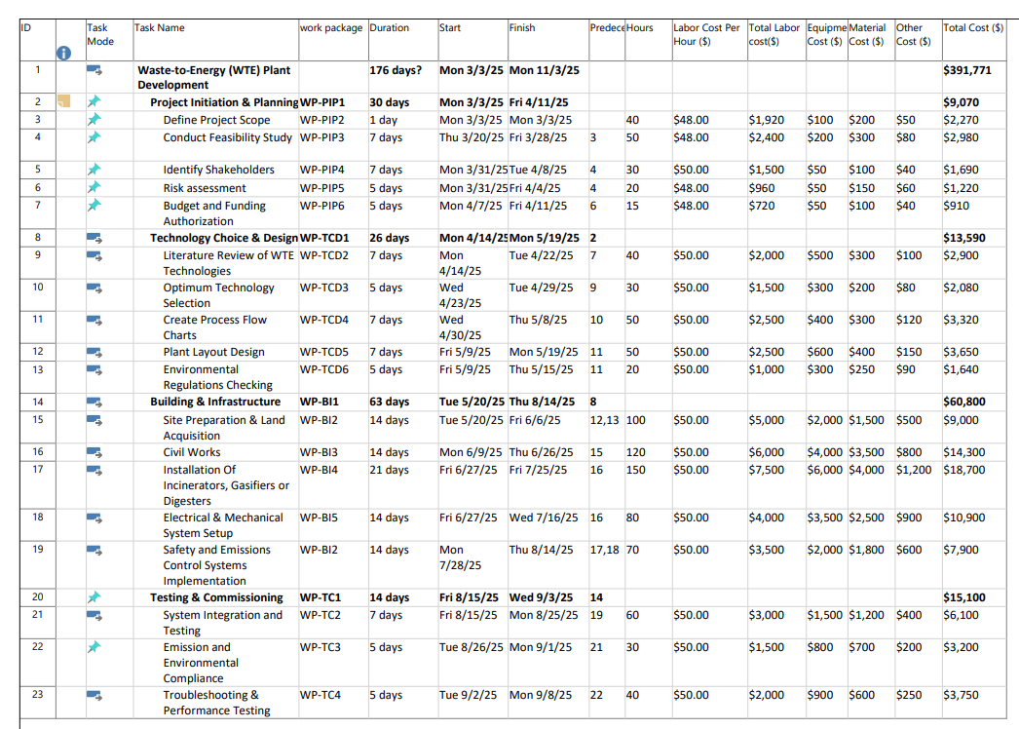
Detailed Project Cost Estimate

Slide 18
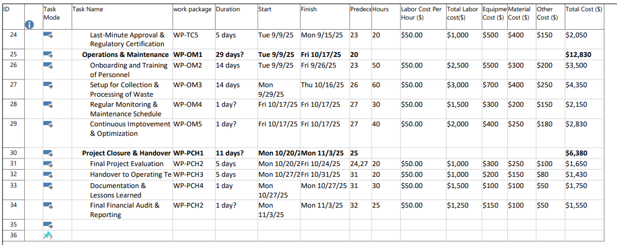
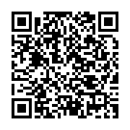
Detailed Project Cost Estimate
https://drive.google.com/file/d/1KpYQHWfDFeCeP7tAn6ok9COOE2V7qXkb/view?usp=sharing
Scan this QR code to view the detailed Project cost estimate

Slide 19
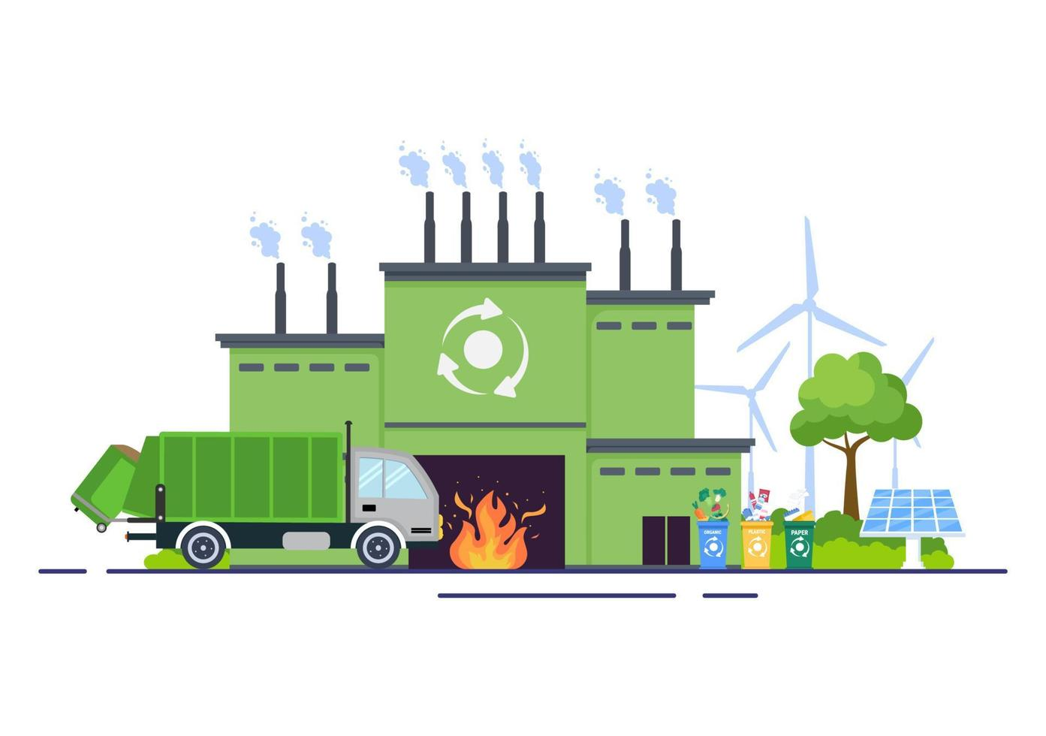
Outsourcing Plan
Outsourced Activities:
Civil works
Installation of equipment
Emission control systems
Electrical & mechanical setup
Contractor Selection Criteria:
Certifications and experience
Budget compatibility
Technical expertise
Past project references

Slide 20
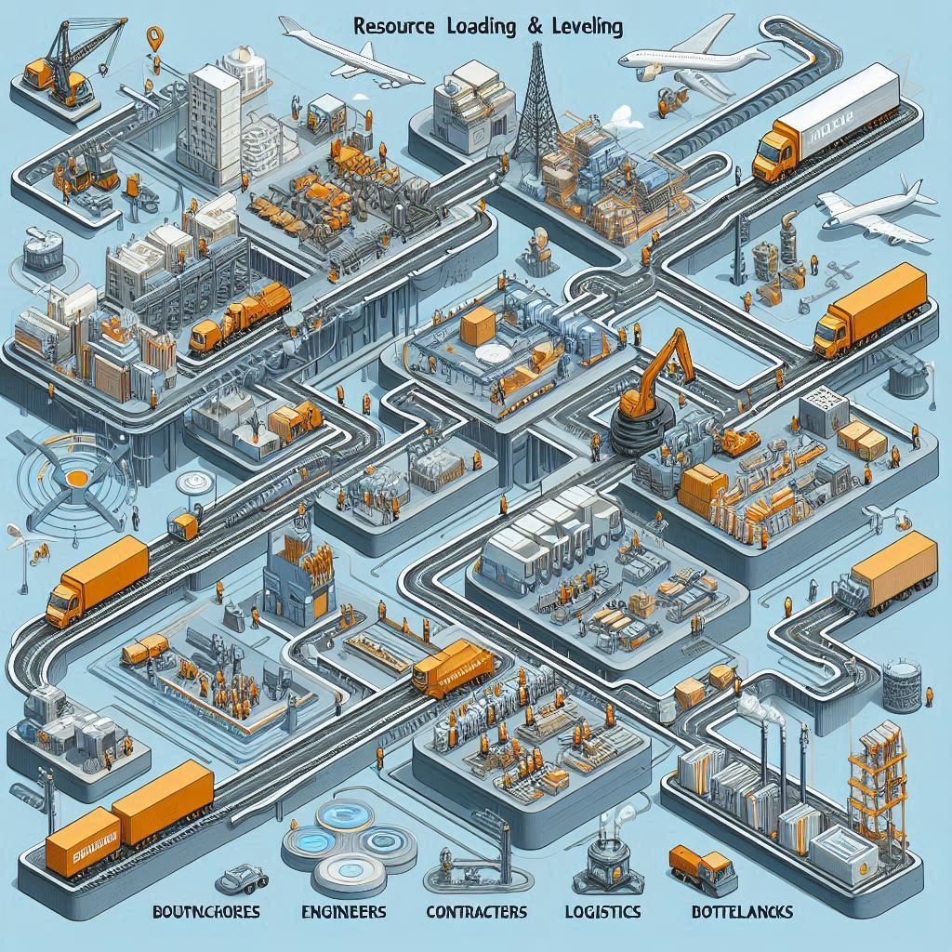
Resource Loading & Leveling
Resources: Engineers, contractors, specialists, logistics
Leveled across parallel tasks
Integrated with outsourcing plan to avoid bottlenecks

Slide 21
Risk Mitigation
Risk ID | Description | Mitigation Action
A | Unavailability of suitable land for waste processing plant | Coordinate well in advance with municipal authorities for leasing or allocation of land
B | Inability to secure consistent municipal waste supply | Sign MoUs with city waste departments for regular waste sourcing
C | Emission levels exceeding environmental regulations | Add emission control technology and conduct regular audits
D | Mechanical failures in turbines or digesters | Perform regular maintenance regimen and keep backup units operational
E | Absence of qualified technicians or engineers | Participate with local technical institutes and provide training

Slide 22
Risk Mitigation
Risk ID | Description | Mitigation Action
F | Risk of cost overruns or delayed funding | Maintain contingency budget and use multi-source funding
G | Local resistance to waste treatment | Stage awareness campaigns and conduct community participation sessions
H | Government delays in approvals or environmental permits | Start paperwork early and maintain regular contact with regulatory agencies
I | Unanticipated natural catastrophes (e.g., floods that disrupt plant operations) | Design plant with disaster-resistant infrastructure and acquire insurance
J | Sensor data inaccuracies impacting electricity output optimization | Implement IoT-based systems with redundancy and data validation checks

Slide 23
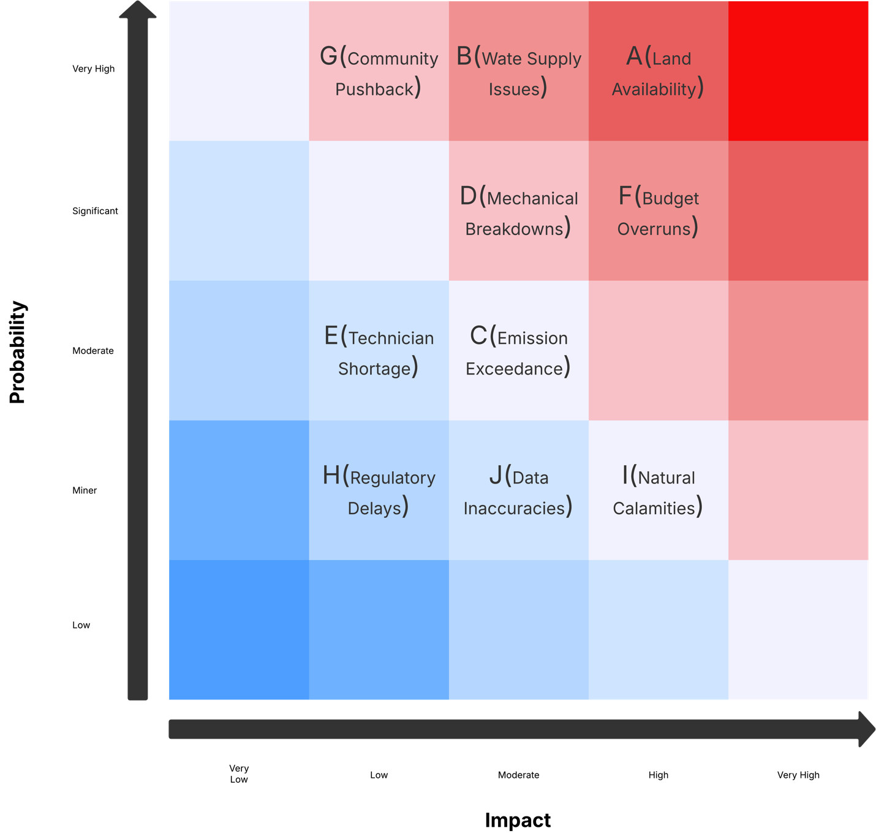
Risk Mitigation

Slide 24
Quality Control Plan
Quality Area | Control Method | Frequency | Responsible Party
Waste Input Quality | Pre-sorting of waste and segregation based on sensors | Daily | Operations Engineer
Emission Monitoring | Real-time automatic emission sensors with automatic alerting | Continuous | Environmental Compliance Officer
Energy Output Efficiency | Match actual output against projected output through analytics | Weekly | Plant Supervisor
Equipment Performance | Monitor turbine/digester efficiency, plan predictive maintenance | Bi-Weekly | Maintenance Team

Slide 25
Quality Control Plan
Quality Area | Control Method | Frequency | Responsible Party
Accuracy of Data Logging | Sensor calibration and system check | Monthly | Data Analyst
Safety Inspections | HSE audits, emergency drills, PPE inspections | Bi-Monthly | Safety Officer
Community Feedback | Gather stakeholder opinion on operations | Quarterly | PR and Engagement Officer
Regulatory Compliance | Environmental and safety regulation audits | Quarterly | Compliance Officer

Slide 26
Monitoring & Change Management
Weekly progress reviews and KPI dashboards
Milestone-based tracking
Change requests handled via formal process (CRF)
Approvals by project steering committee
Budget vs. Actual Cost Tracking
Tracked using spreadsheet-based dashboard
Variances flagged >10%
Adjustments applied monthly

Slide 27
Lessons Learned & Project Summary
Lessons:
Early outsourcing saves delays
Regulatory prep must start immediately
Design iterations improve long-term efficiency
Summary:
Sustainable, cost-efficient solution for municipal waste
Cross-functional integration of tech, planning, and execution

Slide 28



